Slide 1
PCA and Clustering Assignment
By:
Balakrishna Gadiyar

Slide 2
Abstract :
HELP International is an international humanitarian NGO that is committed to fighting poverty and providing the people of backward countries with basic amenities and relief during the time of disasters and natural calamities. It runs a lot of operational projects from time to time along with advocacy drives to raise awareness as well as for funding purposes.
After the recent project that included a lot of awareness drives and funding programmes, they have been able to raise around $ 10 million
Business Objectives :
The Objective of analysis is to ,
Categorize the countries based on socio economic and health factors on its development
Suggest countries which CEO needs to focus on the most for his investment.

Slide 3
Approach
Understand the raw data and business need
Import and perform EDA
Visualize the correlations and get further understanding on the data
Perform SVD on the Dataframe and view the outcomes
Conduct PCA - Scale and transform, conduct outlier analysis, remove outliers
Review variance ratio, see how many components cover 80-85%.
Using hopkins statistics see if the clustering needed
Considering the components derived perform silhouette score and SSD analysis
Analyze the clusters formed using k means and hierarchical approach
Review/Visualize Principal components and Origial features to understand the key components that influence.
Using Kmeans+ predict the segmentations using identified clusters
Analyze segments on derived features by taking means on the segments and see if they really fall in correct groups
Visualize the segmentation to arrive at conclusion
Filter countries from original dataset based on key features and suggest

Slide 4
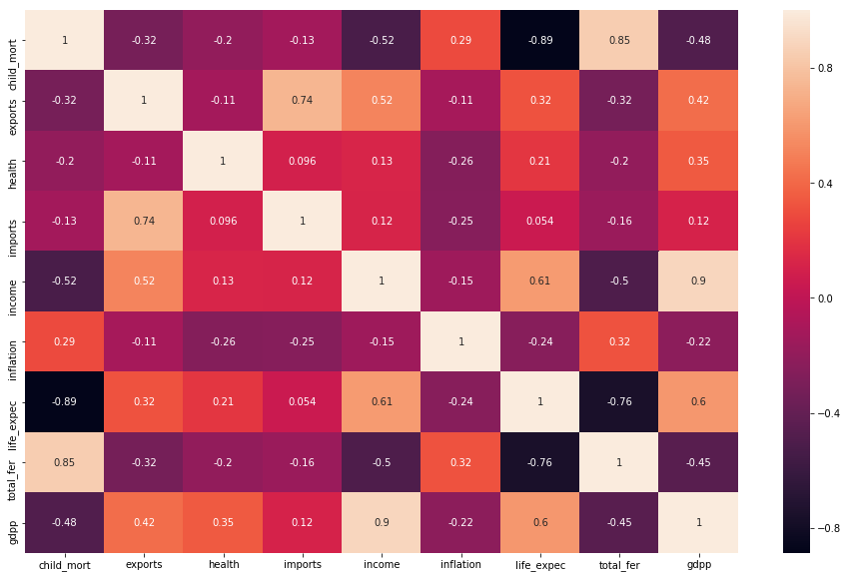
Correlations among origial features

Slide 5
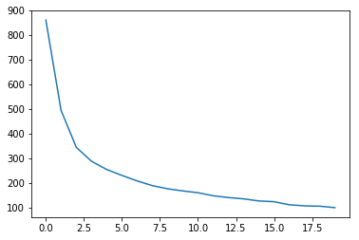
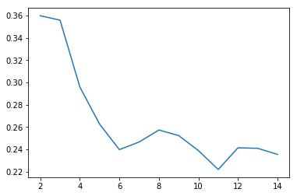
PCA – SSD/ Silhoute analysis
Silhoute
SSD

Slide 6
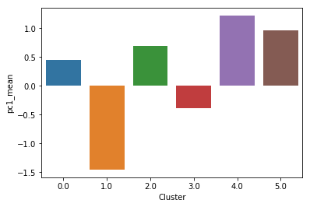
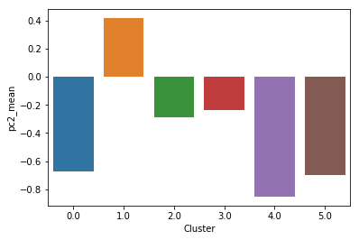
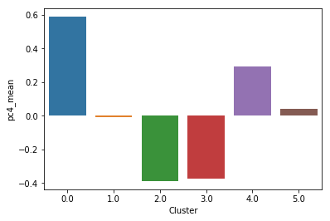


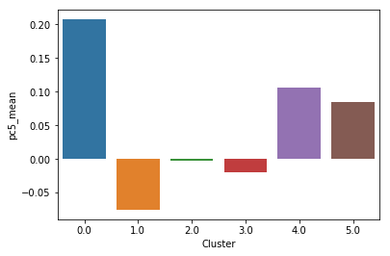
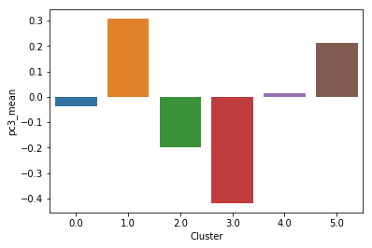
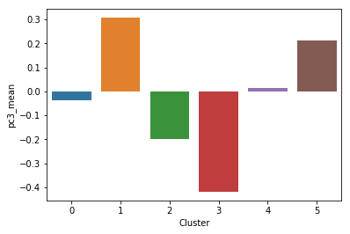


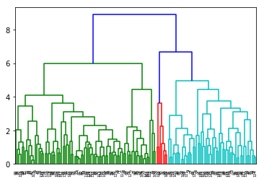
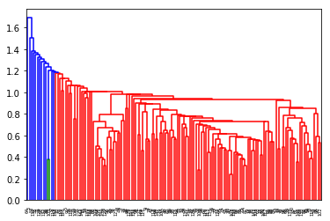
K Means/Hierarchical Analysis
K Means
Hierarchical
Analysis

Slide 7
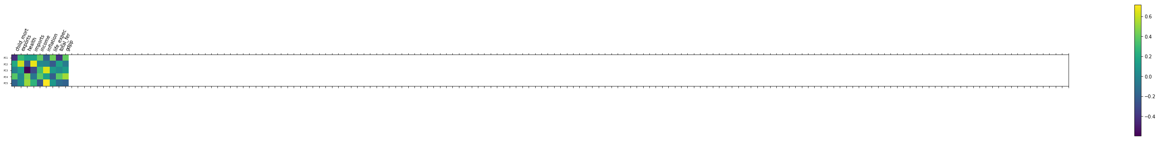
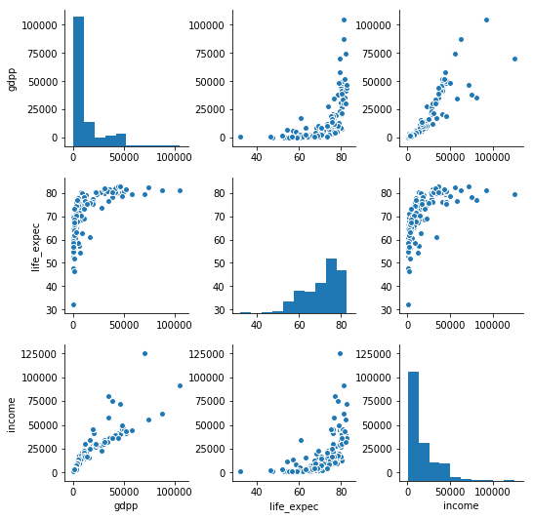
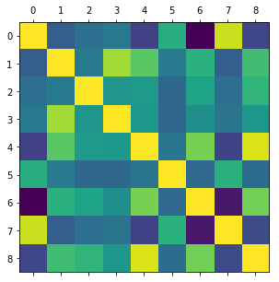
PC Vs Original Features
child_mort
exports
health
imports
income
inflation
life_expec
total_fer
gdpp
Heatmap
Original Features

Slide 8
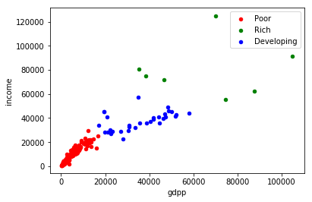
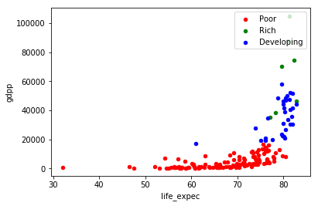
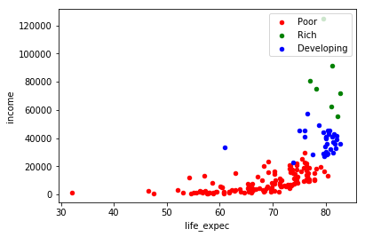
Feature Analysis

Slide 9
Conclusion
Segment | country | gdpp | life_expec | income | child_mort
Poor | Burundi | 231 | 57.7 | 764 | 93.6
Poor | Liberia | 327 | 60.8 | 700 | 89.3
Poor | Congo, Dem. Rep. | 334 | 57.5 | 609 | 116
Poor | Niger | 348 | 58.8 | 814 | 123
Poor | Sierra Leone | 399 | 55 | 1220 | 160
Poor | Madagascar | 413 | 60.8 | 1390 | 62.2
Poor | Mozambique | 419 | 54.5 | 918 | 101
Poor | Central African Republic | 446 | 47.5 | 888 | 149
Poor | Malawi | 459 | 53.1 | 1030 | 90.5
Poor | Eritrea | 482 | 61.7 | 1420 | 55.2
Poor | Togo | 488 | 58.7 | 1210 | 90.3
Poor | Guinea-Bissau | 547 | 55.6 | 1390 | 114
Poor | Afghanistan | 553 | 56.2 | 1610 | 90.2
Poor | Gambia | 562 | 65.5 | 1660 | 80.3
Poor | Rwanda | 563 | 64.6 | 1350 | 63.6
Poor | Burkina Faso | 575 | 57.9 | 1430 | 116
Poor | Nepal | 592 | 68.3 | 1990 | 47
Poor | Uganda | 595 | 56.8 | 1540 | 81
Poor | Guinea | 648 | 58 | 1190 | 109
Poor | Haiti | 662 | 32.1 | 1500 | 208
Countries are divided into 3 categories
Poor
Developing
Rich
Primary features that are considered for decision making are
Income
Gdp
life expectancy
Primary investing segment should be poor counties whose gdp, income and life expectancy are low
Child mortality feautre is also directly relates to segrement, specially poor countries.

